Slide 1
What Does Open Science look-like
Nicole Jimenez, Ph.D.

Slide 2
Nicole's Research Area
Microbiome and Gynecologic
Cancers
Host-Microbe
Interactions
Womxn's Health Research
Putative Oncogenic Bacteria
Cervical cancer
Endometrial cancer
Bacterial Vaginosis Associated Bacteria
Beneficial Bacteria
Microbiome and Benign Conditions
Adenomyosis
Biomarker Discovery
Chronic Pelvic Pain
Endometriosis
Microbiome and Health Disparities
Minimally Invasive Diagnostics
Early Diagnostics
Microbiome and Pregnancy
Drug Discovery
In vitro fertilization
Latinx and Cervical Cancer
Native American and Cervical Cancer
Preterm Premature Rupture of Membranes
https://github.com/jimeneznr
https://herbstkralovetzlab.weebly.com/

Slide 3
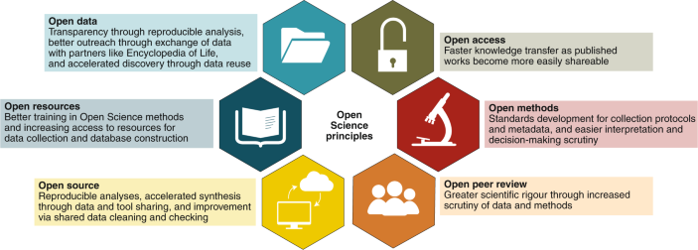
Open-Science

Slide 4
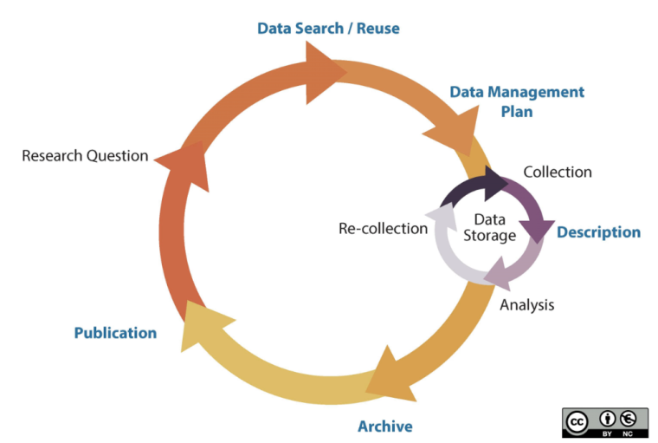
Data Management
The 2023 policy is entirely new. Beginning in 2023, ALL grant applications or renewals that generate Scientific Data must now include a robust and detailed plan for how you will manage and share data during the entire funded period. This includes information on data storage, access policies/procedures, preservation, metadata standards, distribution approaches, and more. You must provide this information in a data management and sharing plan (DMSP). The DMSP is similar to what other funders call a data management plan (DMP).
https://data.library.arizona.edu/data-management/best-practices
https://data.library.arizona.edu/data-management/nih-data-management-sharing-policy-2023

Slide 5
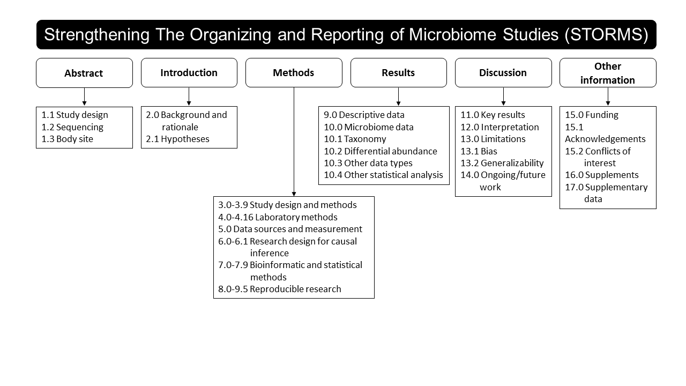
Strengthening The Organization and Reporting of Microbiome Studies (STORMS)
https://www.stormsmicrobiome.org/

Slide 6
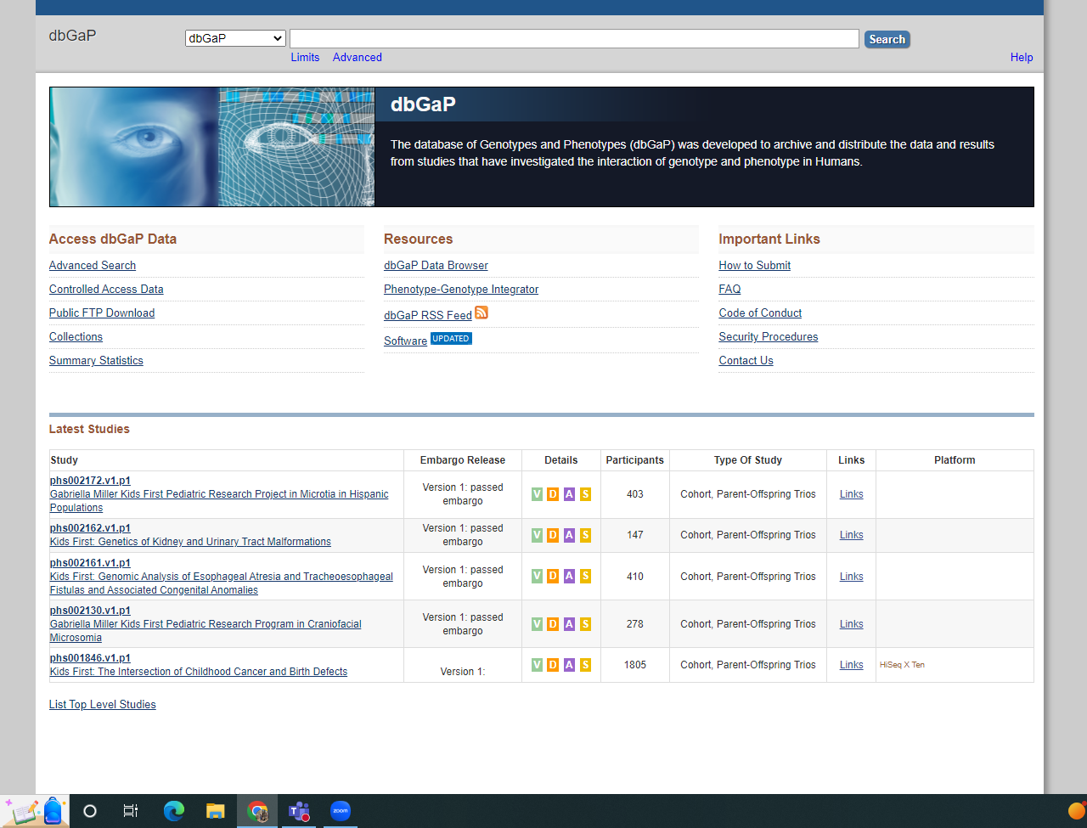
DbGaP - database of Genotypes and Phenotypes
https://www.ncbi.nlm.nih.gov/gap/
https://www.ncbi.nlm.nih.gov/genome/microbes/
chrome-extension://efaidnbmnnnibpcajpcglclefindmkaj/https://www.ncbi.nlm.nih.gov/projects/gap/cgi-bin/GetPdf.cgi?document_name=HowToSubmit.pdf

Slide 7
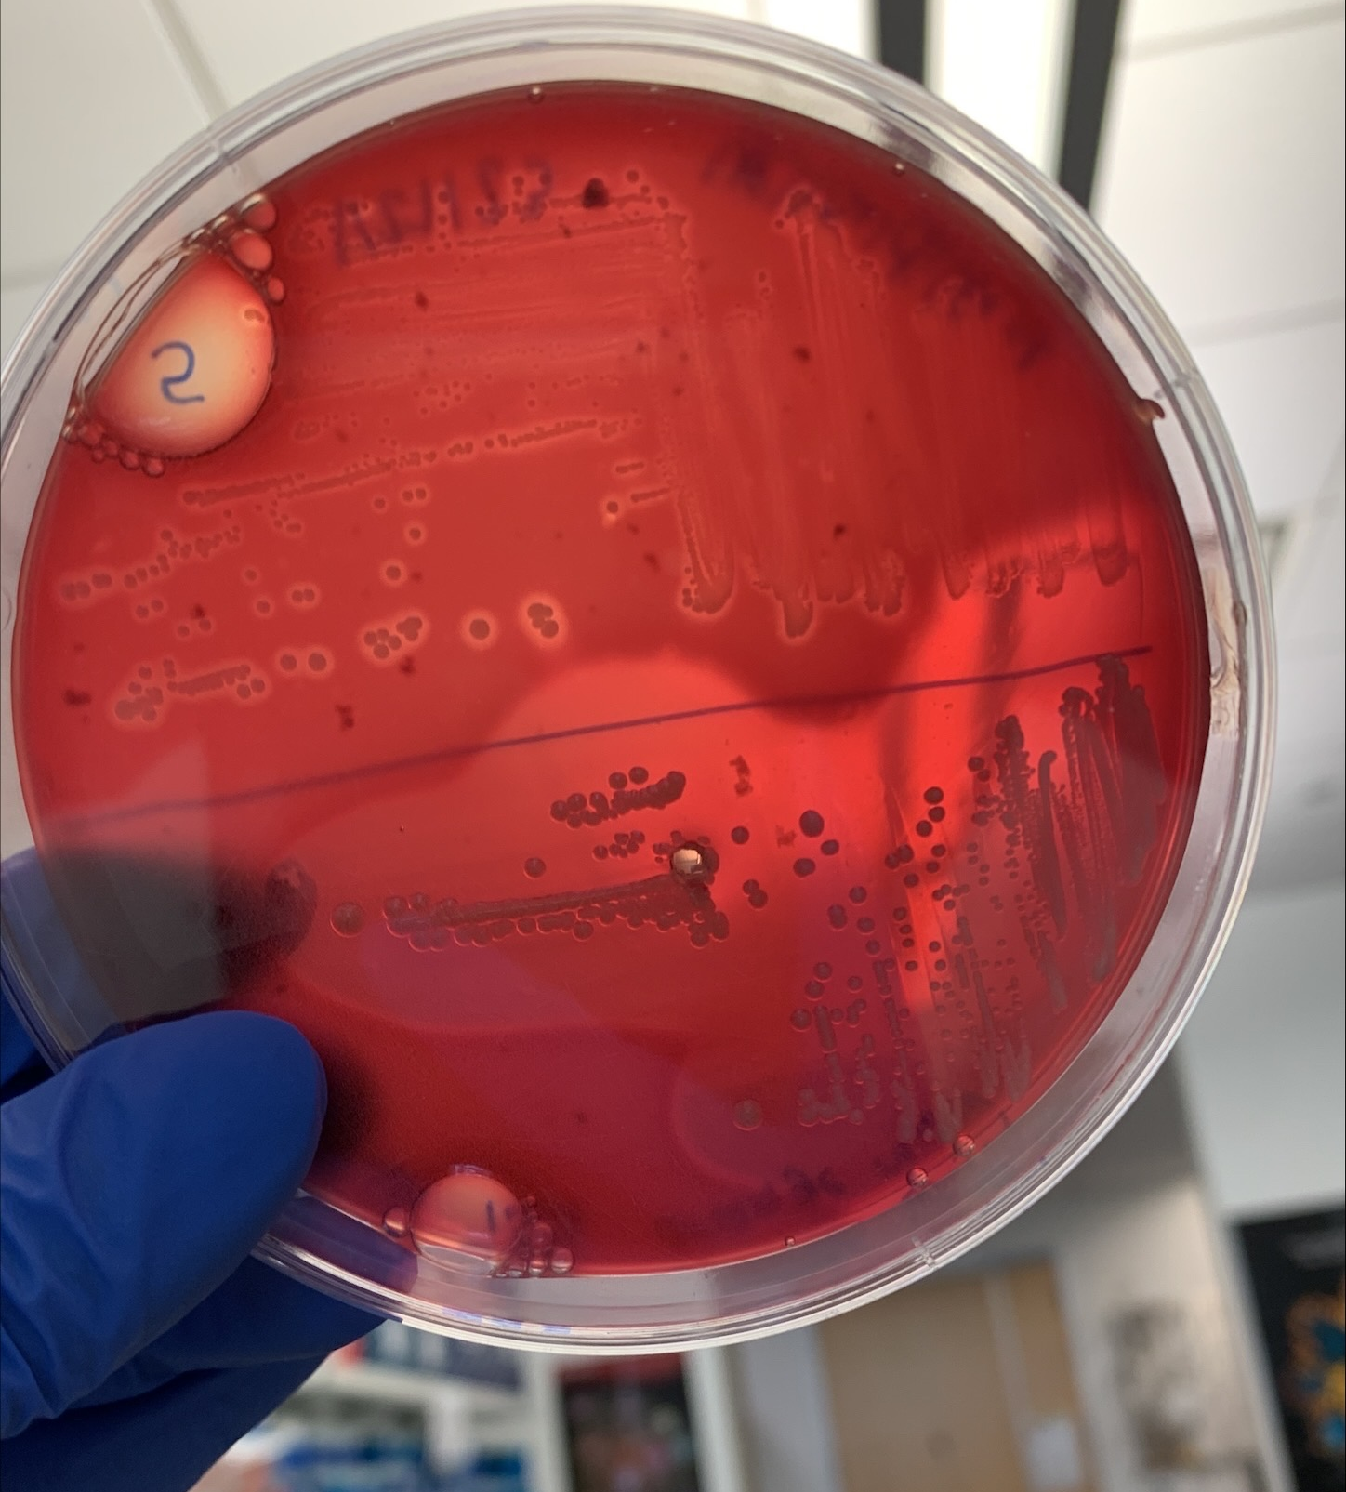
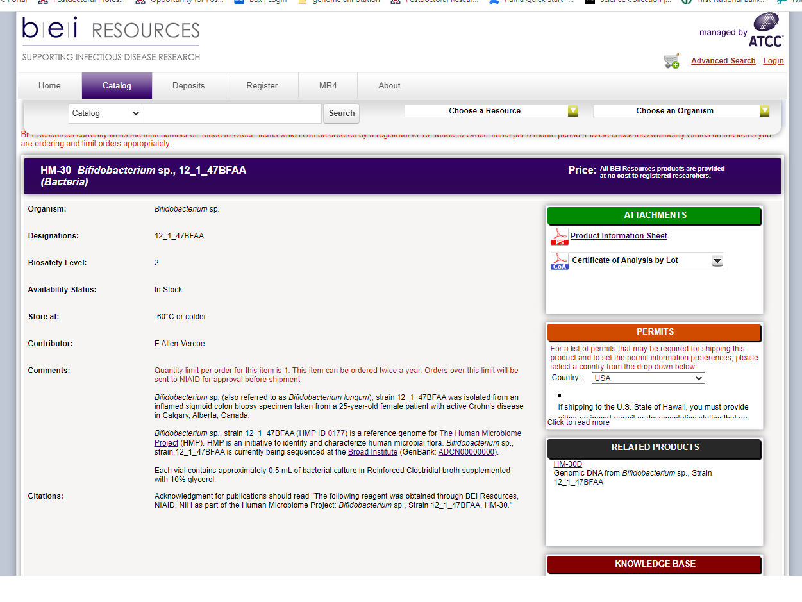
Biospecimen Repositories -BEI
https://www.beiresources.org/Home.aspx
https://www.impactt-microbiome.ca/platform-3-microbial-human-tissue-repositories/

Slide 8
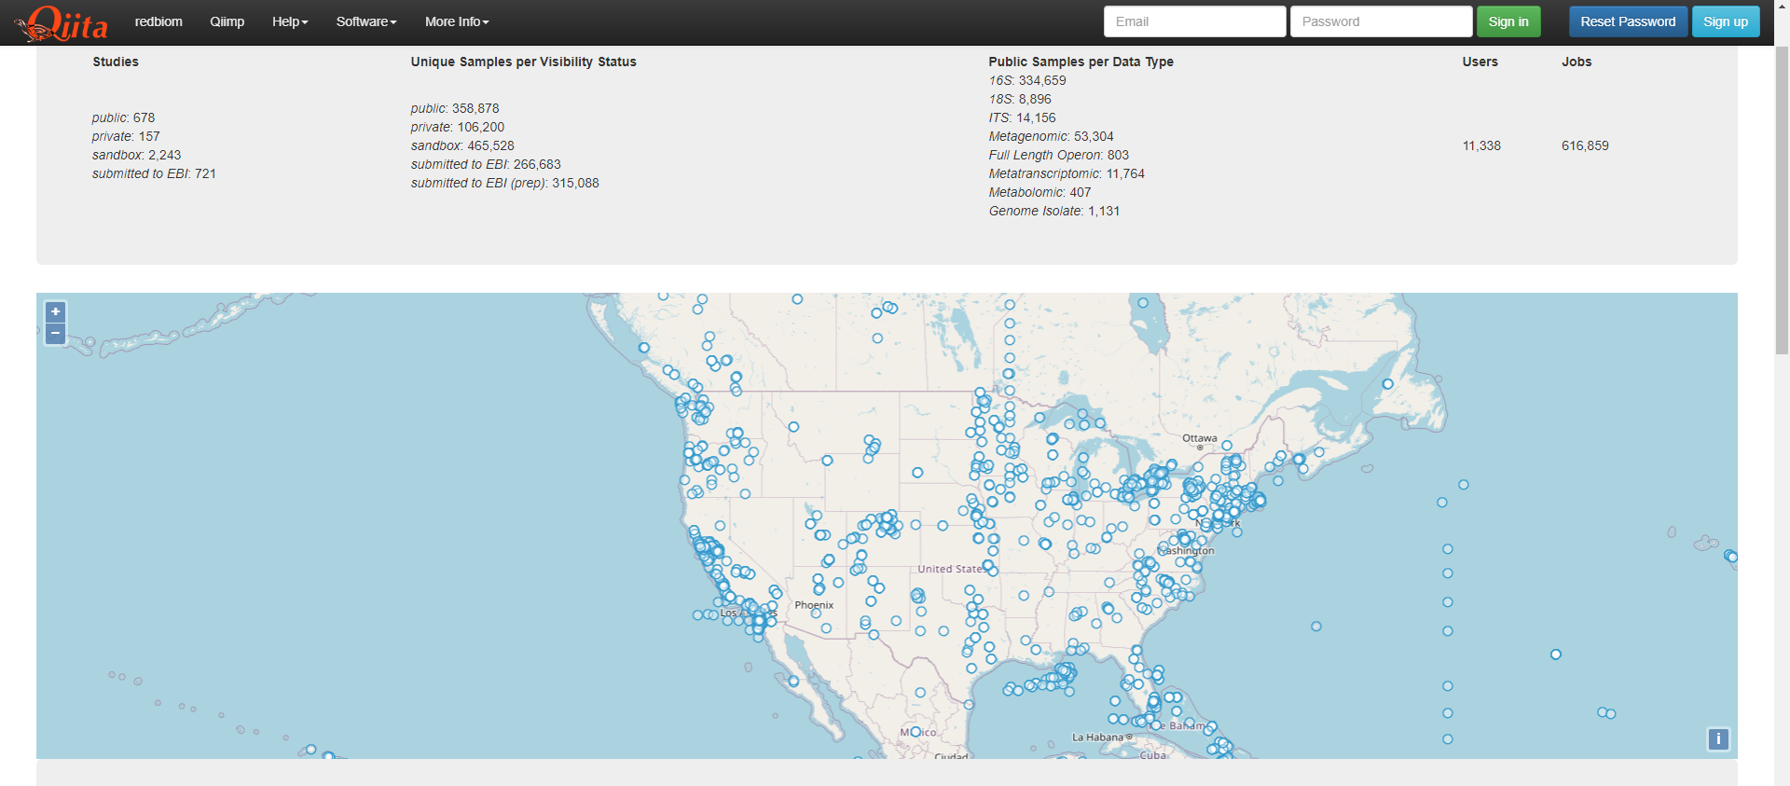
Qiita
https://qiita.ucsd.edu/
Qiita (canonically pronounced cheetah) is a software package intended for analysis and administration of multi-omics datasets.
Qiita provides a free and open platform for users to:
Easily share and reuse existing data-sets in the form of studies.
Perform analyses (by combining one or more studies/data-sets) using published and unpublished data that meet the standards as described by this documentation.
Easily interface with the EBI repository for automated deposition. Query and interact with Qiita data programmatically.

Slide 9
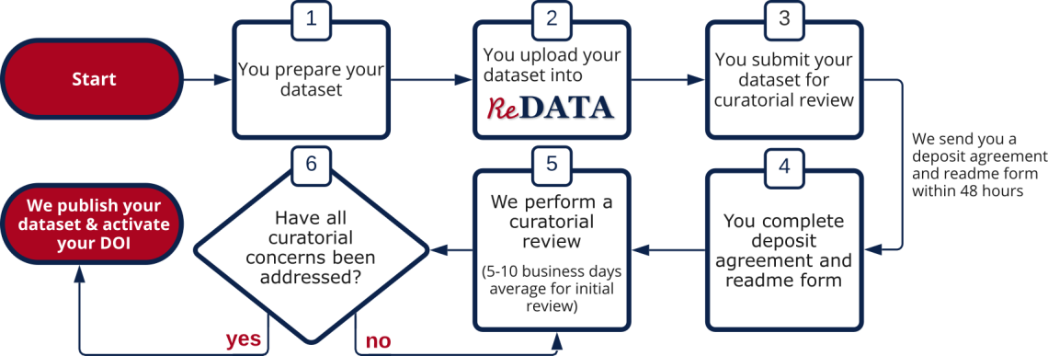
ReData
Exceptions & restrictions
You may deposit any kind of research output into ReDATA except for:
Sensitive, restricted, or legally protected data including but not limited to HIPAA, FERPA, PII, ITAR, CUI, etc. Our sensitive data flyer contains more information on what types of data can and cannot be published.
Deposits consisting solely of standalone manuscripts (e.g., journal articles, theses/dissertations, reports). These should go in the UA Campus Repository
You may deposit human subjects data as long as:
All human subjects data have been de-identified
Consent has been obtained for making this data publicly available or for use in future research
The UA Research Data Repository Policies document contains sample language for IRB purposes under the "De-identified Data Associated With Human Subjects Research" section. After submitting the deposit, the corresponding author (or the authorized depositor) will be asked to confirm adherence to these exceptions and restrictions through the Deposit Agreement.
https://data.library.arizona.edu/data-management/services/research-data-repository-redata

Slide 10
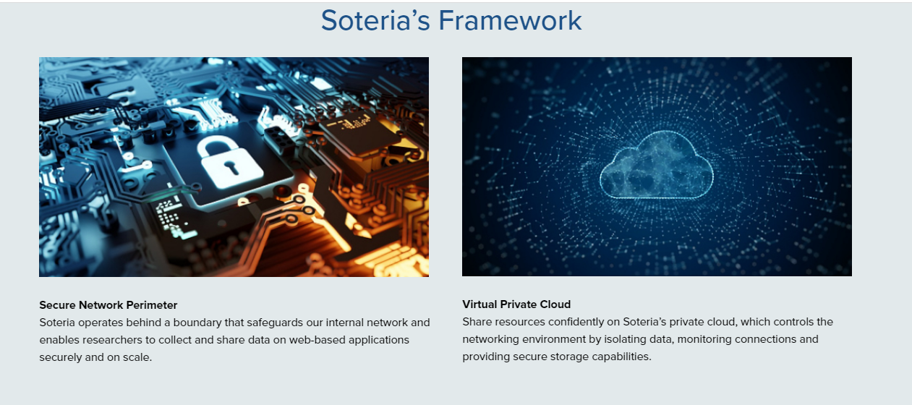
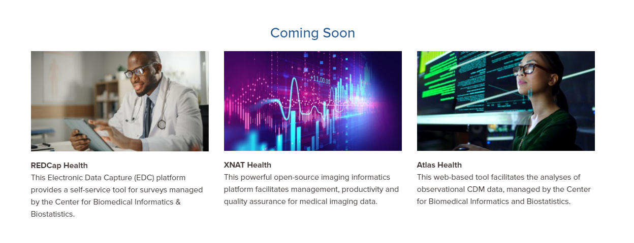
Soteria
https://datascience.arizona.edu/analytics-powerhouse/ua-soteria

Slide 11
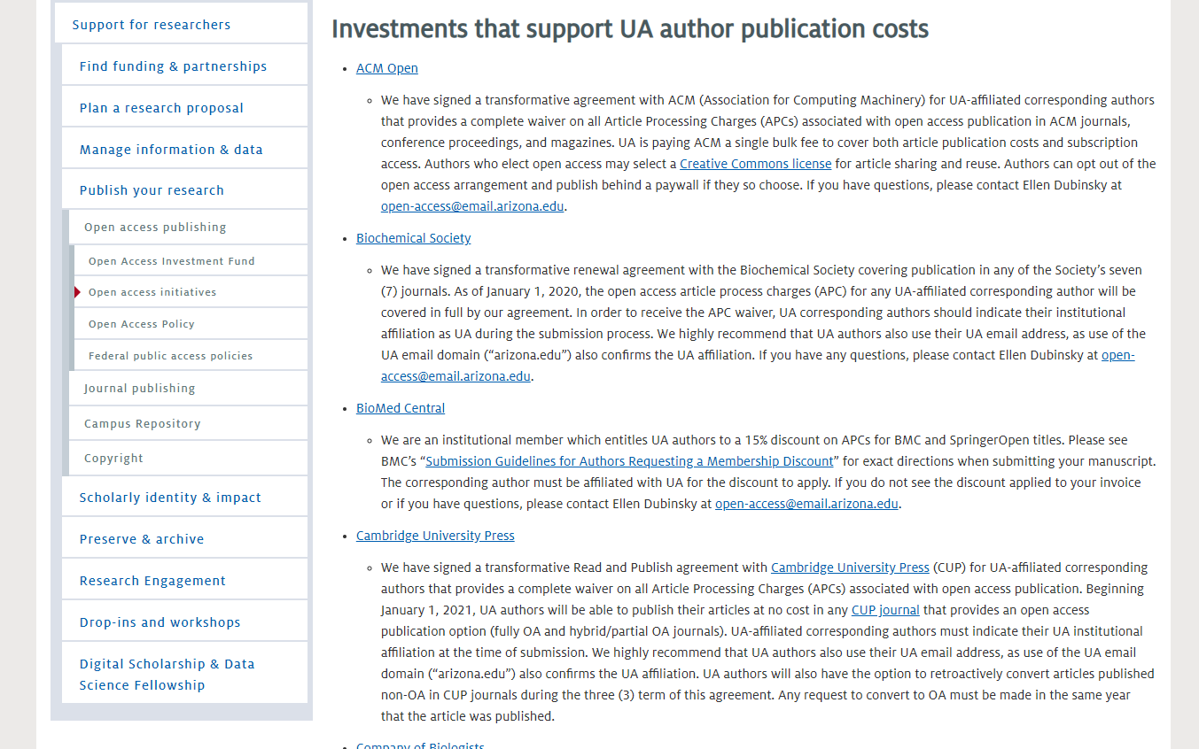
UA Open Access Publishing
https://new.library.arizona.edu/research/open-access/initiatives
https://new.library.arizona.edu/research/open-access#:~:text=Open%20access%20is%20a%20publishing,to%20reading%20discovery%2C%20and%20sharing.

Slide 12
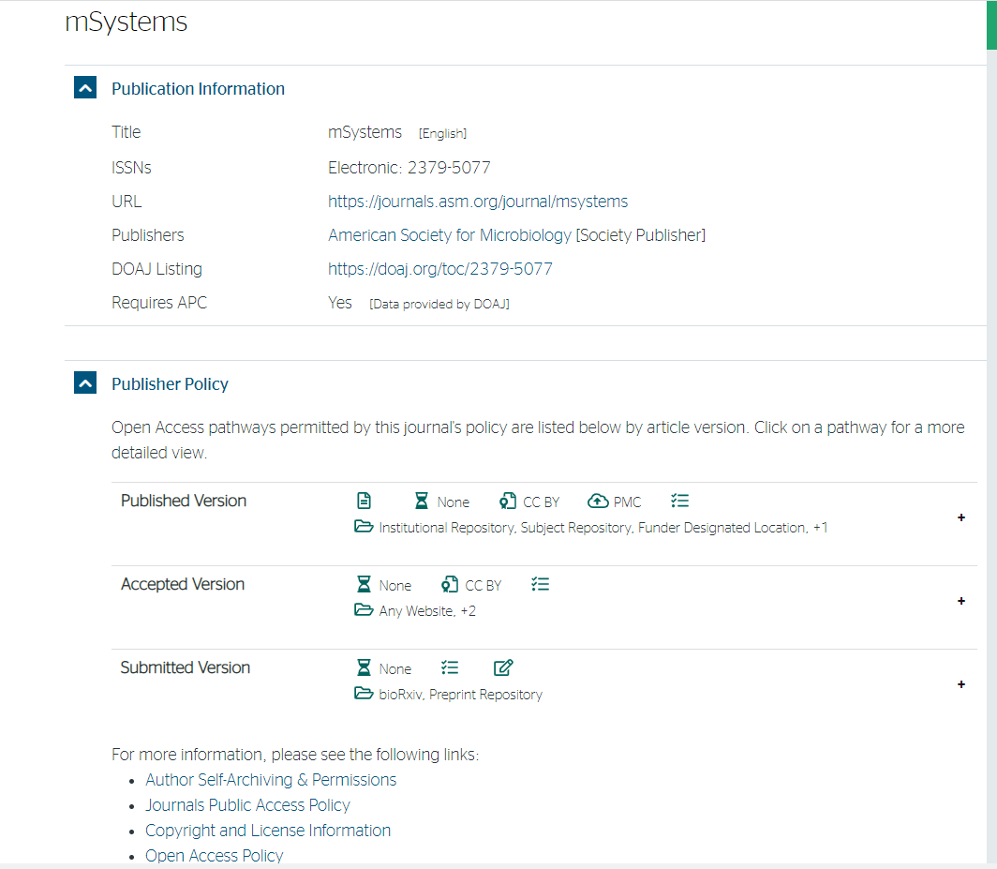
Sherpa romeo
Sherpa Romeo is an online resource that aggregates and presents publisher and journal open access policies from around the world. Every registered publisher or journal held in Romeo is carefully reviewed and analyzed by our specialist team who provide summaries of self-archiving permissions and conditions of rights given to authors on a journal-by-journal basis where possible.
https://v2.sherpa.ac.uk/romeo/search.html

Slide 13
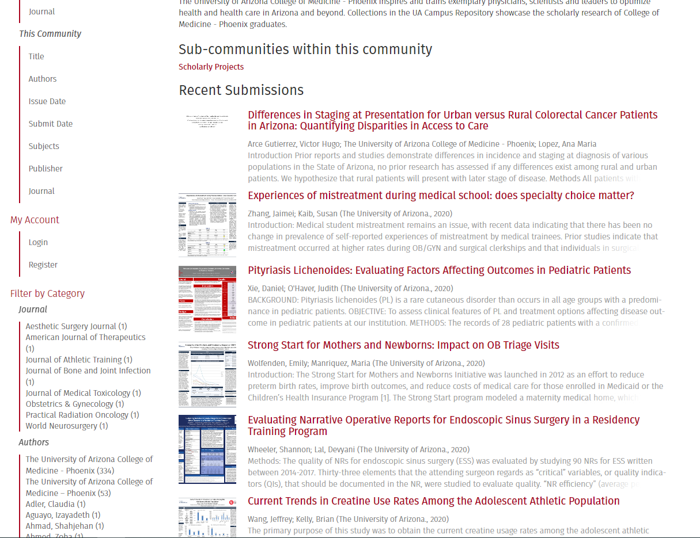
UA Repository
UA Campus Repository, a service of the University of Arizona Libraries. The repository shares, archives and preserves unique digital materials from faculty, staff, students and affiliated contributors. Visit About page to learn more about the types of digital materials we accept and our policies.
https://repository.arizona.edu/

